Slide 1

Course code : CSE3009 Course title : No SQL Data Bases Module : 6 Topic : 7
Page Rank Algorithm

Slide 2
Objectives
This session will give the knowledge about
Graph Algorithms Introduction
Page Rank computation using Iterative Processing
Page Rank computation using Random Walk

Slide 3
Introduction to Graph Algorithms
For transactions and operational decisions, you need real-time graph analysis to provide a local view of relationships between specific data items and take action.
To make discoveries about the overall nature of networks and model the behavior of complex systems, you need graph algorithms.
Graph algorithms provide the means to understand, model and predict complicated dynamics such as the flow of resources or information, the pathways through which contagions or network failures spread, and the influences on and resiliency of groups.

Slide 4
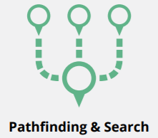

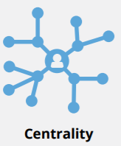
Type of Graph Algorithms
Algorithm Type | Graph Problem | Example
 | Find the optimal path or evaluate route availability and quality | Find the quickest route to travel from A to B Telephone call routing
 | Determine the importance of distinct nodes in the networks | Determine social media influencers Find likely attack targets in communication and transportation networks
 | Evaluate how a group is clustered or partitioned | Segment customers Find potential members of a fraud ring

Slide 5
Introduction to Graph Algorithms
Traversal & Pathfinding Algorithms
Parallel Breadth-First Search (BFS)
Parallel Depth-First Search (DFS)
Single-Source Shortest Path
All-Pairs Shortest Path
Minimum Weight Spanning Tree (MWST)
Centrality Algorithms
PageRank
Degree Centrality
Closeness Centrality
Betweenness Centrality

Slide 6
Introduction to Graph Algorithms
Community Detection Algorithms
Label Propagation
Strongly Connected
Union-Find / Connected Components / Weakly Connected
Louvain Modularity
Local Clustering Coefficient / Node Clustering Coefficient
Triangle-Count and Average Clustering Coefficient

Slide 7
Page Rank Algorithm
PageRank is an algorithm that measures the transitive, or directional, influence of nodes.
All other centrality algorithms measure the direct influence of a node, whereas PageRank considers the influence of your neighbors and their neighbors.
For example, having a few influential friends could raise your PageRank more than just having a lot of low-influence friends.
PageRank is named after Google co-founder Larry Page, and is used to rank websites in Google’s search results. It counts the number, and quality, of links to a page which determines an estimation of how important the page is.

Slide 8
Page Rank - when to use
Personalized PageRank is used by Twitter to present users with recommendations of other accounts that they may wish to follow.
PageRank has been used to rank public spaces or streets, predicting traffic flow and human movement in these areas. The algorithm is run over a graph which contains intersections connected by roads, where the PageRank score reflects the tendency of people to park, or end their journey, on each street.
PageRank can be used as part of an anomaly or fraud detection system in the healthcare and insurance industries. It can help find doctors or providers that are behaving in an unusual manner, and then feed the score into a machine learning algorithm.

Slide 9
Page Rank – when NOT to use
There are some things to be aware of when using the PageRank algorithm:
If there are no links from within a group of pages to outside of the group, then the group is considered a spider trap.
Rank sink can occur when a network of pages form an infinite cycle.
Dead-ends occur when pages have no out-links. If a page contains a link to another page which has no out-links, the link would be known as a dangling link.

Slide 10
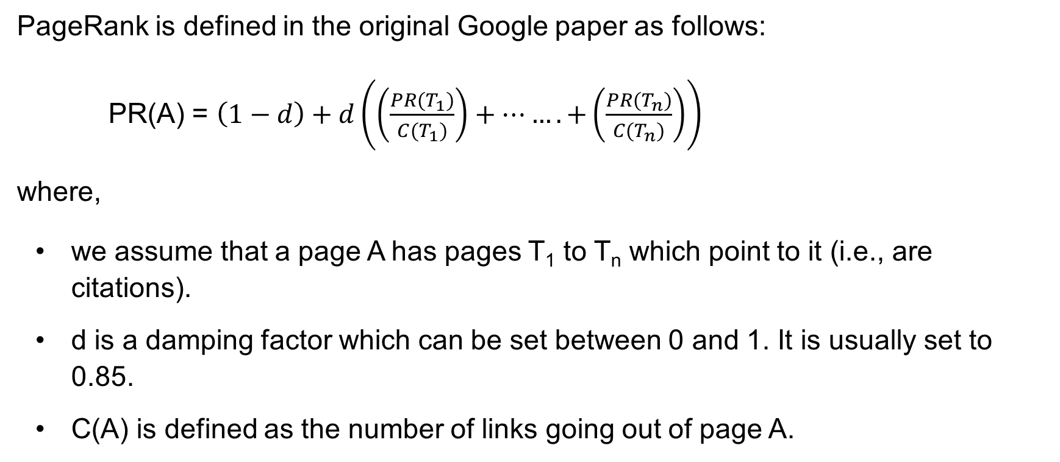
Page Rank Algorithm
PageRank is defined in the original Google paper as follows:
PR(A) = $\left(1−d\right)+d\left(\left(\frac{PR(T_{1})}{C(T_{1})}\right)+…….+\left(\frac{PR(T_{n})}{C(T_{n})}\right)\right)$
where,
we assume that a page A has pages T₁ to T_{n} which point to it (i.e., are citations).
d is a damping factor which can be set between 0 and 1. It is usually set to 0.85.
C(A) is defined as the number of links going out of page A.

Slide 11
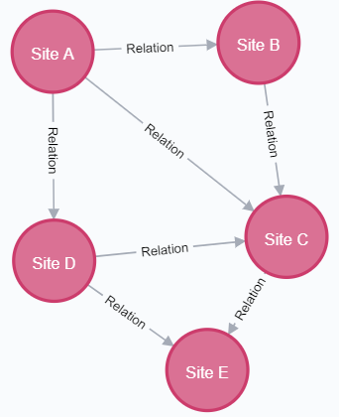
PageRank computation : Example
Compute the page rank score for the given graph

Slide 12
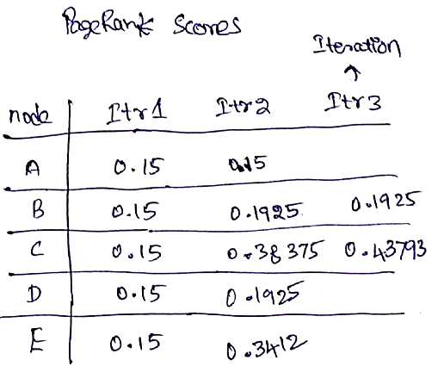
PageRank computation : Example

Slide 13
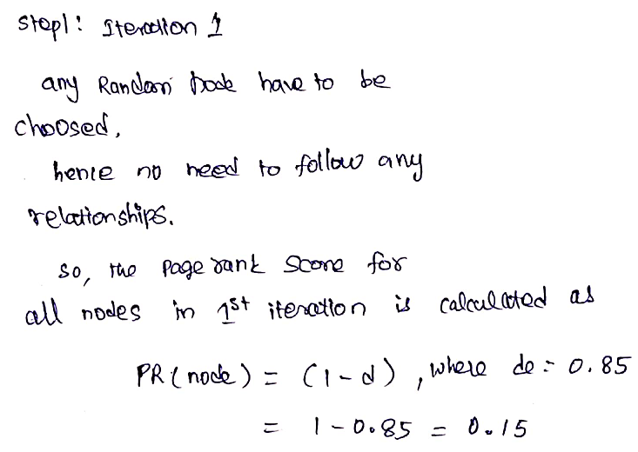
PageRank computation : Example

Slide 14
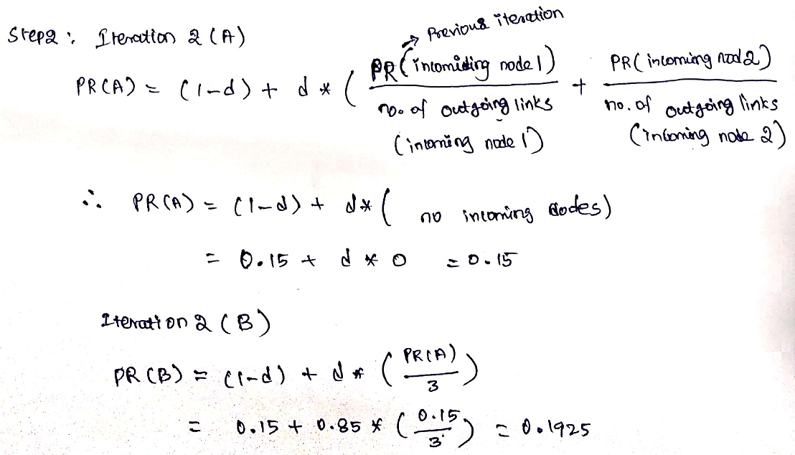
PageRank computation : Example

Slide 15
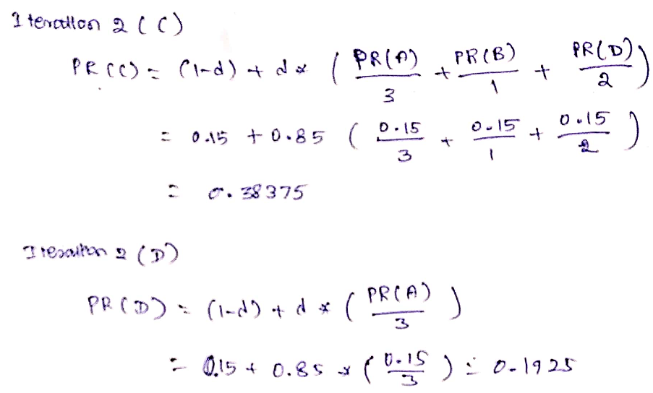
PageRank computation : Example

Slide 16
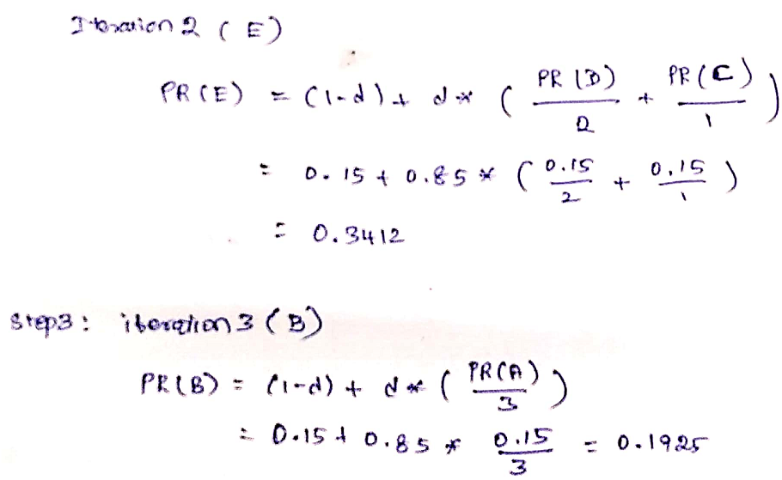
PageRank computation : Example

Slide 17
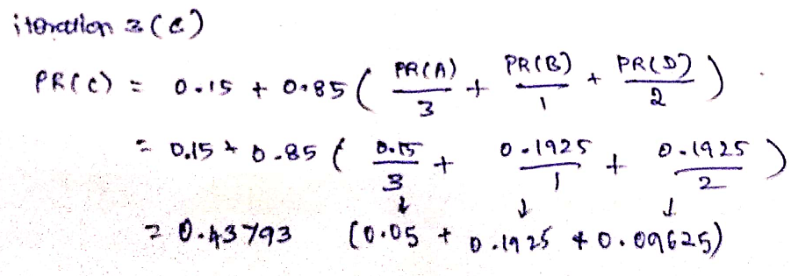
PageRank computation : Example

Slide 18
PageRank computation in Neo4j
MERGE (a:Page {name:'Site A'})
MERGE (b:Page {name:'Site B'})
MERGE (c:Page {name:'Site C'})
MERGE (d:Page {name:'Site D'})
MERGE (e:Page {name:'Site E'})
MATCH (x:Page), (y:Page) WHERE x.name = "Site A"
AND y.name = "Site B"
CREATE (x)-[: Relation]->(y)

Slide 19
Return Clause
MATCH (x:Page), (y:Page) WHERE x.name = "Site A" AND y.name = "Site C"
CREATE (x)-[: Relation]->(y)
MATCH (x:Page), (y:Page) WHERE x.name = "Site A" AND y.name = "Site D"
CREATE (x)-[: Relation]->(y)
MATCH (x:Page), (y:Page) WHERE x.name = "Site B" AND y.name = "Site C"
CREATE (x)-[: Relation]->(y)

Slide 20
Return Clause
MATCH (x:Page), (y:Page) WHERE x.name = "Site C" AND y.name = "Site E"
CREATE (x)-[: Relation]->(y)
MATCH (x:Page), (y:Page) WHERE x.name = "Site D" AND y.name = "Site C"
CREATE (x)-[: Relation]->(y)
MATCH (x:Page), (y:Page) WHERE x.name = "Site D" AND y.name = "Site E"
CREATE (x)-[: Relation]->(y)

Slide 21
Neo4j command to apply PageRank Algorithm
CALL algo.pageRank.stream('Page', 'Relation', {iterations:1, dampingFactor:0.85})
YIELD nodeId, score
RETURN algo.asNode(nodeId).name AS page,score
ORDER BY score DESC

Slide 22
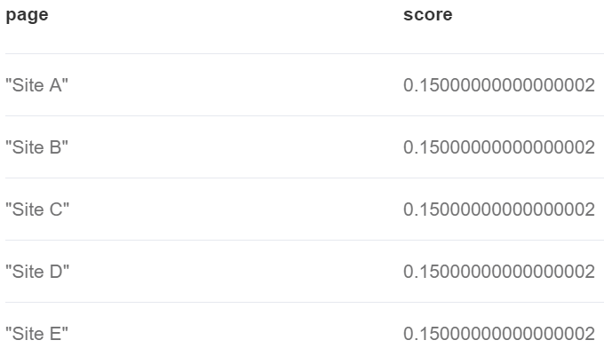
Result: 0th Iteration

Slide 23
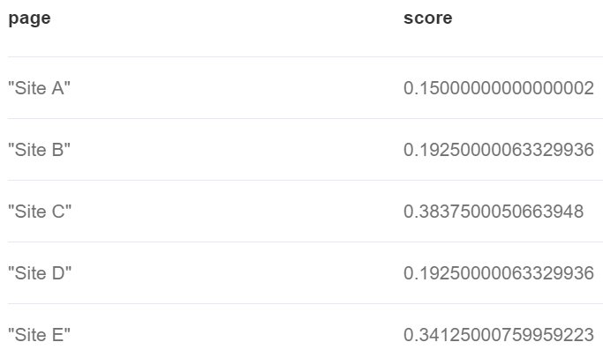
Result: 1st Iteration

Slide 24
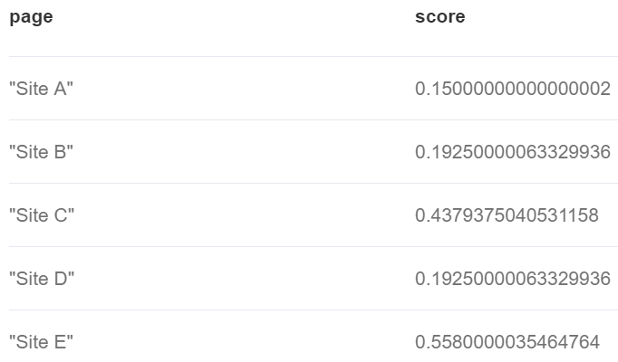
Result: 2nd Iteration

Slide 25
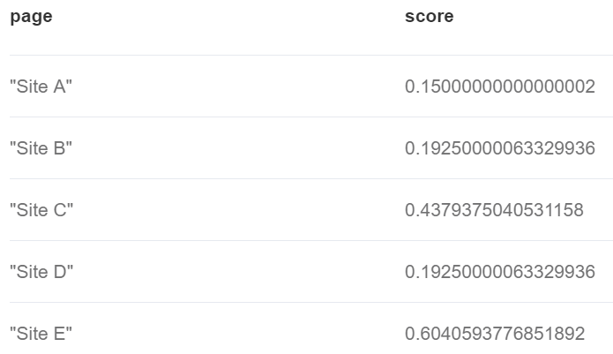
Result: 3rd Iteration

Slide 26
Result: 4th Iteration

Slide 27
Random Walk: PageRank Algorithm
Random Walk is an algorithm that provides random paths in a graph.
A random walk means that we start at one node, choose a neighbor to navigate to at random or based on a provided probability distribution, and then do the same from that node, keeping the resulting path in a list.
The term "random walk" was first mentioned by Karl Pearson in 1905 in a letter to Nature magazine titled The Problem of the Random Walk.

Slide 28
When to use Random Walk
It has be shown to relate to Brownian motion and also to the movement and dispersal of animals in the study of Random walk models in biology.
It has been used to analyze ALSI index of the JSE stock exchange and show that the index followed the random walk hypothesis between years 2000 and 2011.
It can be used as part of the Walktrap and Infomap community detection algorithms. If a random walk returns a small set of nodes repeatedly, then it indicates that those set of nodes may have a community structure.
It can be used as part of the training process of machine learning model, as described in David Mack’s article Review prediction with Neo4j and TensorFlow.

Slide 29
When NOT to use Random Walk
Dead-ends occur when pages have no out-links. In this case, the random walk will abort and a path containing only the first first node will be returned. This problem can be avoided by passing the direction: BOTH parameter, so that the random walk will traverse relationships in both directions
If there are no links from within a group of pages to outside of the group, then the group is considered a spider trap. Random walks starting from any of the nodes in that group will only traverse to the others in the group.
Neo4j implementation of the algorithm doesn’t allow a random walk to jump to non-neighbouring nodes.
Sinks can occur when a network of links form an infinite cycle.

Slide 30
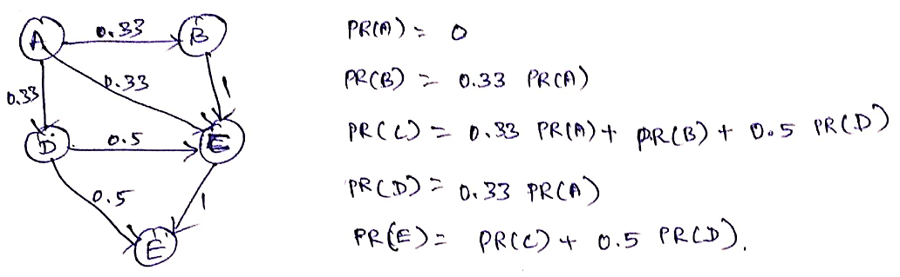
Random Walk Example
The following graph finds the random walk page ranking for the example considered in iteration page rank model.

Slide 31
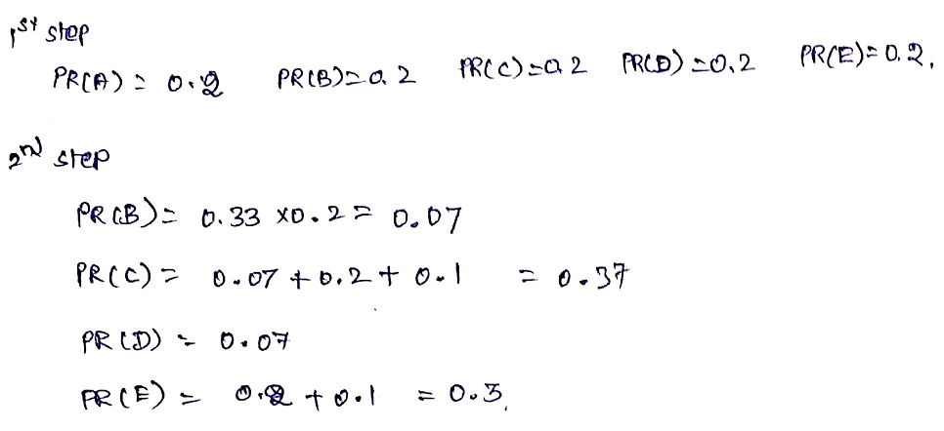
Random Walk Example

Slide 32
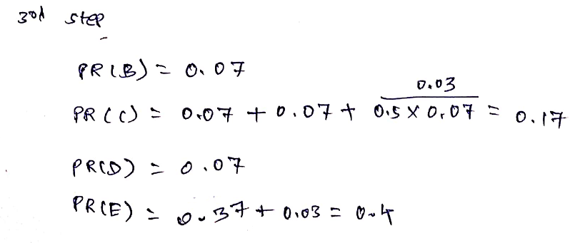
Random Walk Example

Slide 33
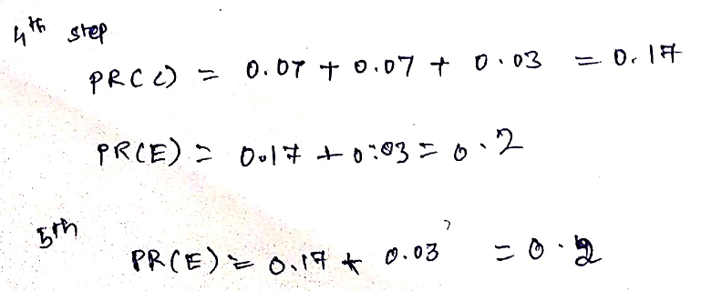
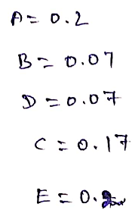
Random Walk Example
Result

Slide 34
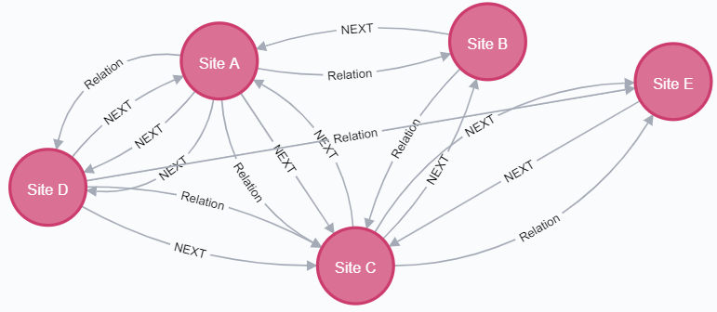
Random Walk Example
The following graph finds the random walk page ranking for the example considered in iteration page rank model.

Slide 35
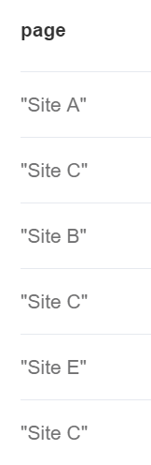
Page Rank score using Random Walk
If node a is selected as starting, 5 number of steps and 1 walk:
MATCH (a:Page {name: "Site A"})
CALL algo.randomWalk.stream(id(a), 5, 1)
YIELD nodeIds
UNWIND nodeIds AS nodeId
RETURN algo.asNode(nodeId).name AS page

Slide 36
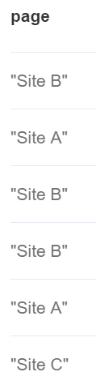
Page Rank score using Random Walk
If node b is selected as starting, 2 number of steps and 2 walk:
MATCH (b:Page {name: "Site B"})
CALL algo.randomWalk.stream(id(b), 2, 2)
YIELD nodeIds
UNWIND nodeIds AS nodeId
RETURN algo.asNode(nodeId).name AS page

Slide 37
Page Rank Path using Random Walk
MATCH (a:Page {name: "Site A"})
CALL algo.pageRank.stream(null, null, {direction: "BOTH", sourceNodes: [a]})
YIELD nodeId, score
MATCH (n) WHERE id(n) = nodeId AND n <> a
RETURN coalesce(n.name, n.title) AS node,
labels(n)[0] AS label,
score,
[node in nodes(shortestpath((a)-[*]-(n))) |
coalesce(node.name, node.title)] AS path
ORDER BY score DESC

Slide 38
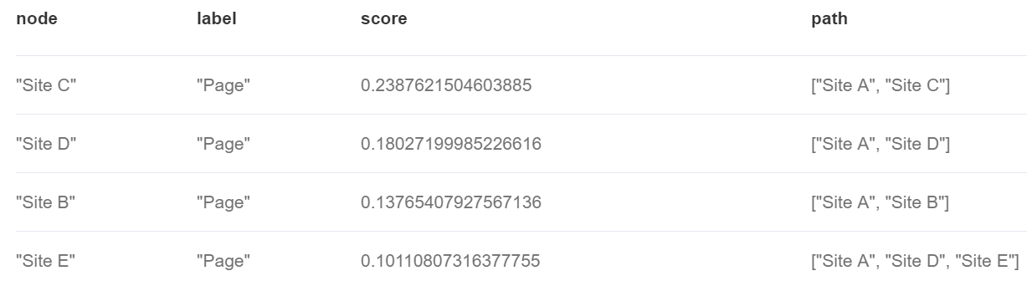
Page Rank Path Output

Slide 39
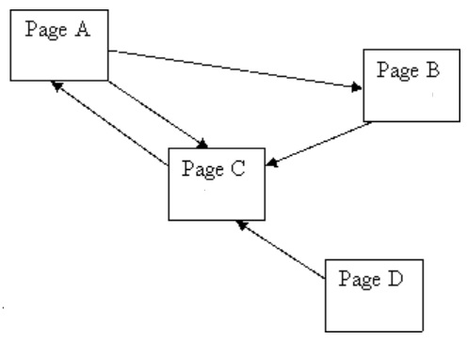
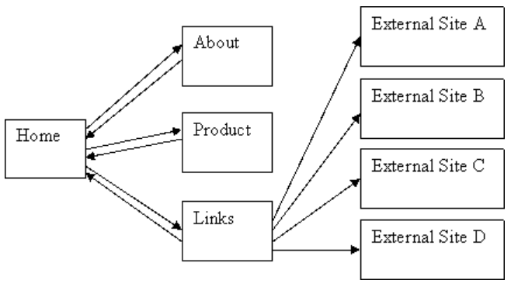
Problems: Iteration processing based Page Rank
Compute the page rank for each node using iterative method and verify it with Neo4j command

Slide 40
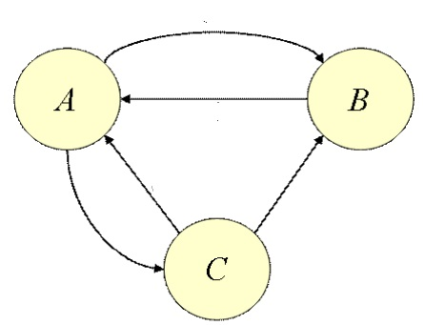
Problems: Random Walk
Compute the page rank for each node using iterative method and verify it with Neo4j command

Slide 41
Summary
This session will give the knowledge about
Graph Algorithms Introduction
Page Rank computation using Iterative Processing
Page Rank computation using Random Walk

